Slide 1
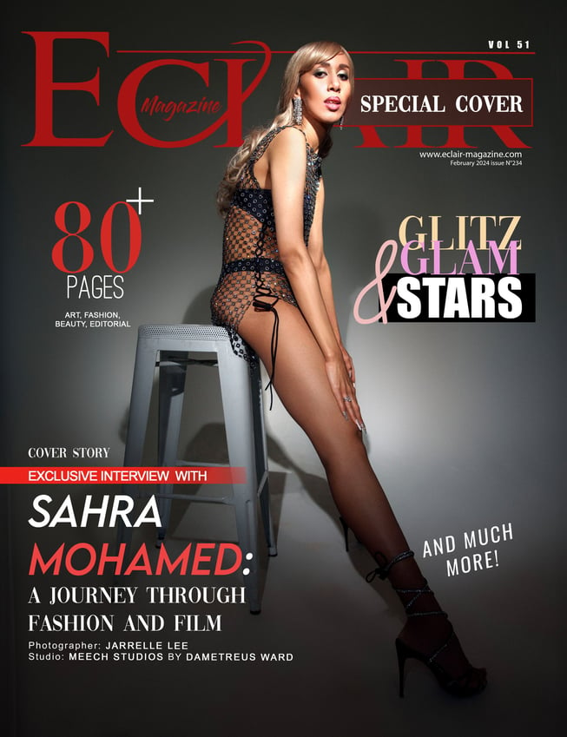
Story
I was an international model for 6 years, working in a lucrative yet very competitive industry. I had the pleasure of meeting and working with passionate artists that truly cared about their craft. However, deciphering the legalities of navigating an unregulated industry was challenging. Often times, agencies participate in bureaucracies that can cause rippling effect to models and any working artist. At the height of my career, I developed a severe eating disorder; Anorexia Nervosa. I almost lost my life.
It took me a long time to recover and thankfully, I now know what it’s like to live in a healthy, functioning body. Being severely malnourished is extremely dangerous, it affects your internal organs, especially your heart and brain. As painful as that experience was, I’m very grateful that I made to the other side and I got another chance to live life.
There’s a lot of stigma around eating disorders and through these images & poetic narration, my hope is to shed light on this issue. I also hope that if anyone is experiencing anxiety and any form of mental illness, that you’re not alone.
According to the National Association of Anorexia Nervosa and Associated Disorders: “Anorexia has the highest case mortality rate and second-highest crude mortality rate of any mental illness”
Welcome to my recovery
We are all worthy of living a full & vibrant life.
Photography and poetry by: Sahra Mohamed

Slide 2
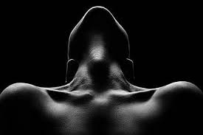
Focus
B &W Image 1 Concept: A person sitting in a chair, head will be tilting, holding a book behind their back
* Wide Shot *
ISO: 100
Aperture: F32
Shutter Speed: 1/1000
“My head was heavy, I was struggling to lift it. Desperate to find the energy to use my brain to its full capacity, seeking to leverage my abilities to learn, to work, to study but each time I found the strength, my head would tilt yet again and the knowledge I just grasped, withered away, like a rose capitulating to the soil beneath. ”

Slide 3
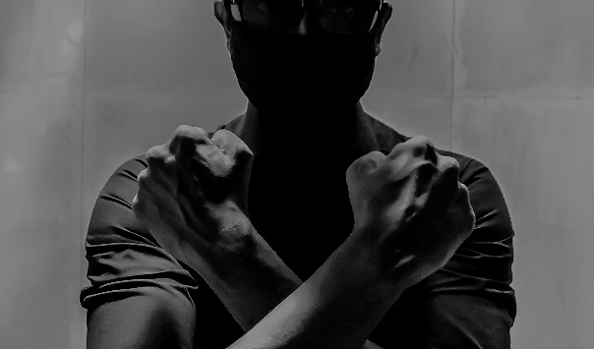
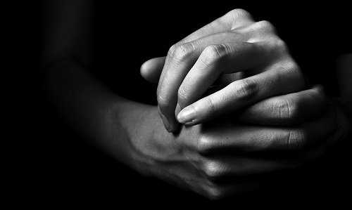
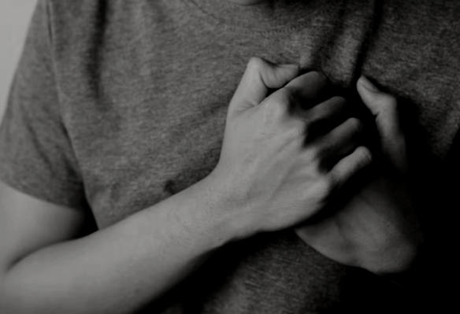
Heart
B &W Image 2 Concept: Knuckles pressing the heart tight
* Close Up Wide Shot *
Iso: 100
Aperture: F22
Shutter Speed: 1/500
“The tension is evident. I was experiencing sporadic patterns throughout my body. Running is my escape and the more I held on to the rails fighting to gain control, the whiter my knuckles became. I’m losing my balance, my heart is weakening but I refuse to accept defeat. The voice in my head said go harder, work faster. My dear, pain is glory. Embrace it”

Slide 4
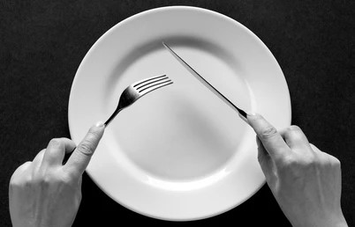
Food
B &W Image 3 Concept: An empty plate and hands holding a fork and a knife. There’s a place mat and an empty cup.
* Close Up Wide Shot *
Iso: 200
Aperture: F16
Shutter Speed: 1/250
“Food was sacred. Allowing myself to enjoy a moment of a meal meant I did well for the day. Surely I must get rid of it before the fat seeps into my veins. Hunger is crushing my mind but I’m doing well.
Food – is the enemy”

Slide 5
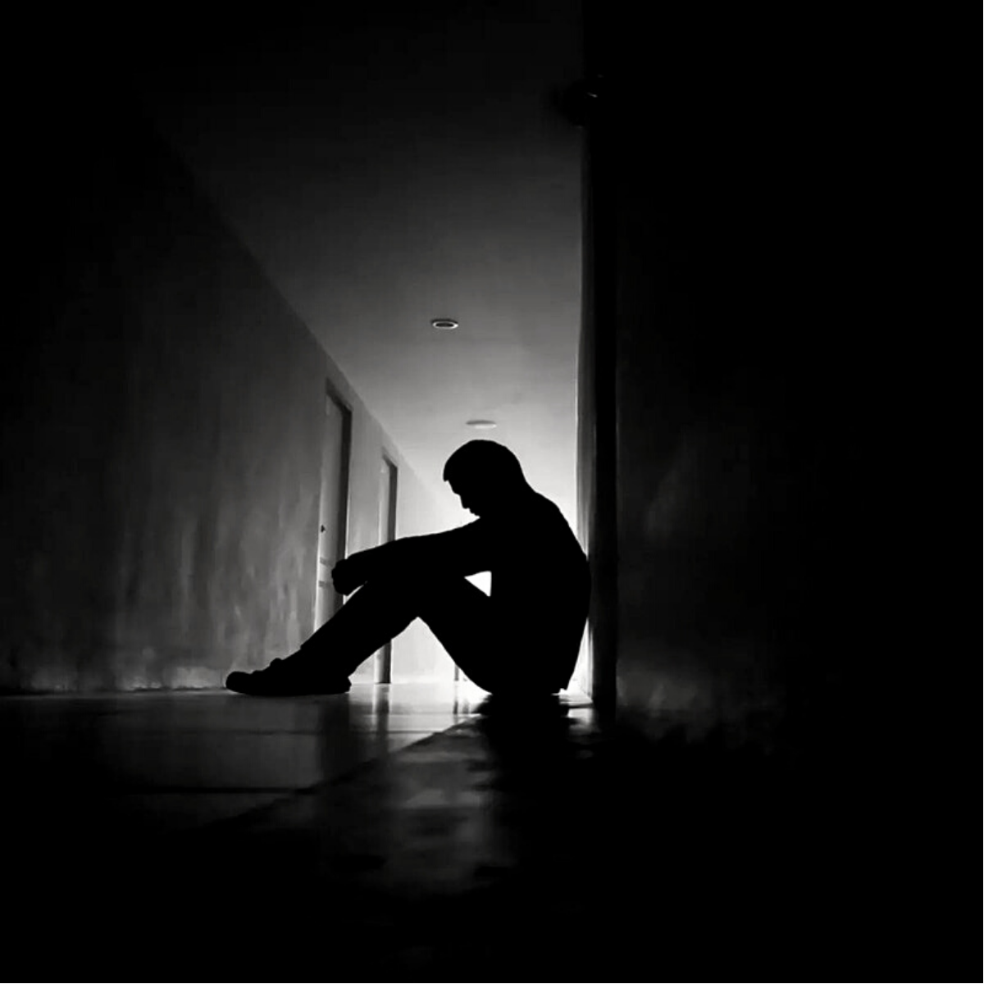
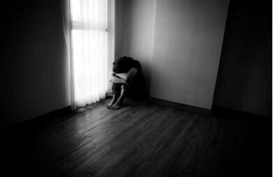
Isolation
B &W Image 4 Concept: Curled up on the floor against the wall
* Wide Shot*
Iso: 50
Aperture: F32
Shutter Speed: 1/1000
“Trapped in an endless cycle; I’m filled with so much pride. Unaware of anyone or any being. Anger took a toll on me and being alone was much more comforting. I’m able to privately congratulate myself for my body’s enfeeblement state”

Slide 6
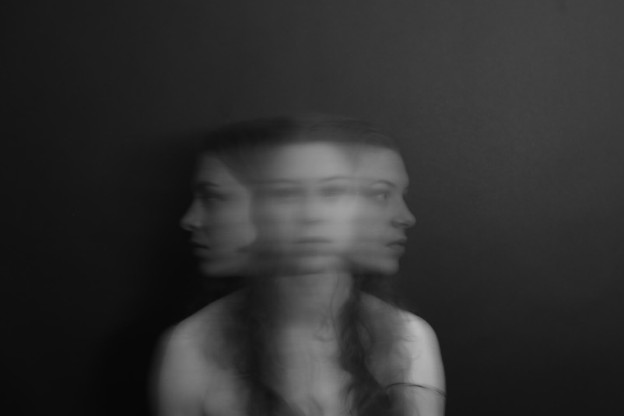
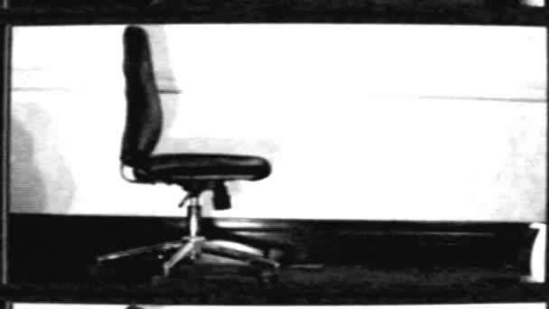
Anxiety
B &W Image 5 Concept: Chair rocking back & forth, head is spinning
* Medium Wide Shot*
Iso: 1600
Aperture: F2.8
Shutter Speed: 1/8
“The deprivation turned me into a fearful cocoon; unable to unravel. I’m in a constant state of survival, fearful of the outside world. I sense the warmth & love from others, a glowing lantern I can’t reach. I preferred remaining in a carefully constructed, beautifully curated, nightmarish of a maze; for I was a prestigious architect. Why should I demolish my creation?
The voice appeared –I was safe here”

Slide 7
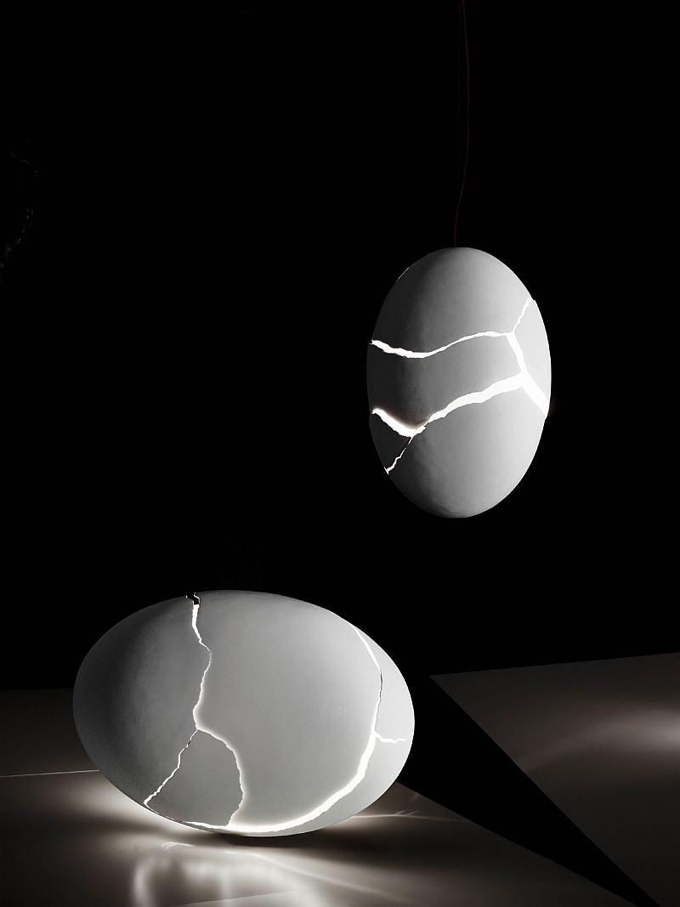
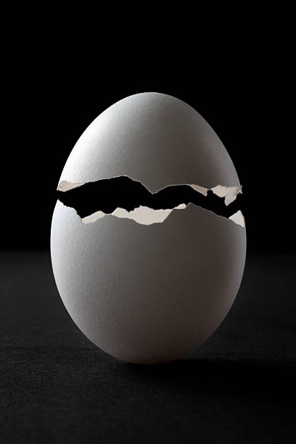
Breakthrough
B &W Image 6 Concept: Eggs being cracked open
* Close up Shot*
Iso: 200
Aperture: F22
Shutter Speed: 1/250
“I understood the monster within, a beast I created. I was gleefully feeding it my soul piece by piece. Until I heard an outside voice -
you will disappear, disintegrate into dust
Have I had enough? I tortured every compartment of my flesh… perhaps there was a way out… another intricate maze? Can I enter a new territory? My mind couldn’t fathom but another noise shook the depths of my core –
My body, my body is weeping”

Slide 8
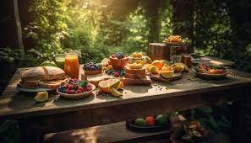
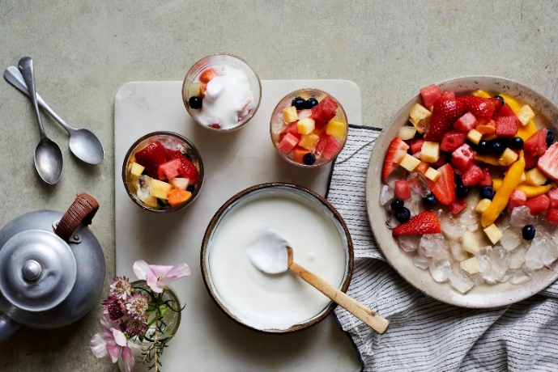
Light
Color Image 7 Concept: Picture of fruit bowls outside
*Medium Wide Shot *
Iso: 100
Aperture: F16
Shutter Speed: 1/500
“I felt taste and panicked. My mind was instantaneously at war. Each bite was a treacherous battle as tears flowed down my cheeks. I felt nourishment and warmth in my throat but the guilt was far too much. I would throw it all away and run but I couldn’t escape anymore. Open and exposed, the glaring light found me and I touched it.”

Slide 9
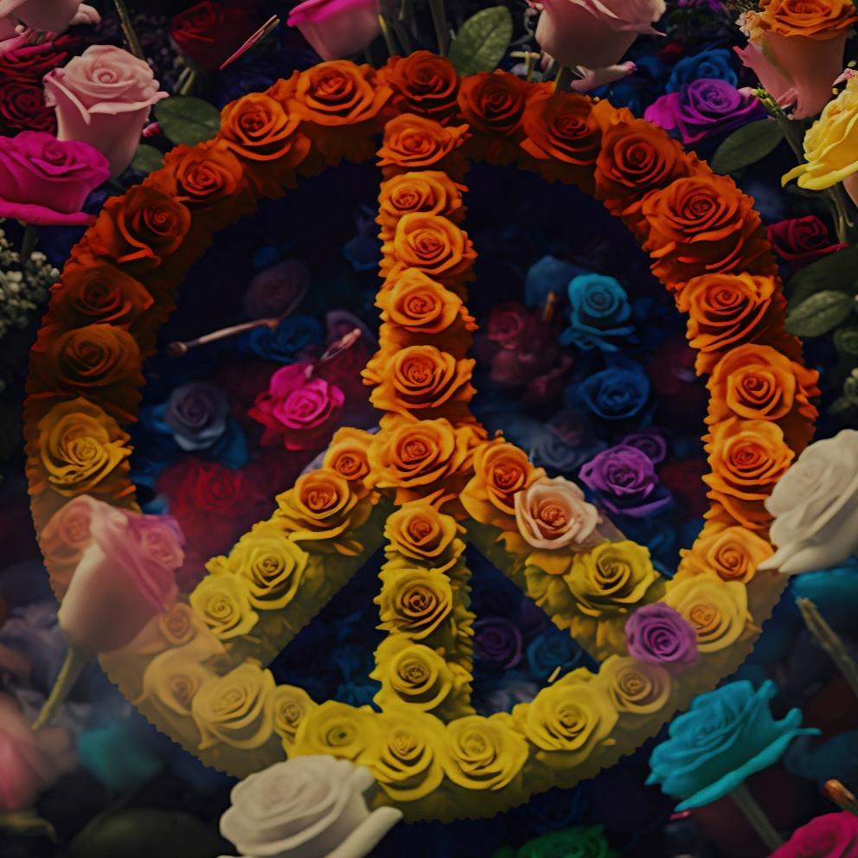
Peace
Color Image 8 Concept: Flowers on the ground in the shape of a peace sign
*Medium Wide Shot * Iso: 100 Aperture: F8 Shutter Speed: 1/30 “My mind awakened and I stood still. For the first time in years, I gave my body grace. The punishment was no longer needed, it occasionally appeared but I controlled the movement – it became less painful. I accepted my past. The trauma is present but as panic-strickened as I am, I’m ready to heal. I need peace.

Slide 10
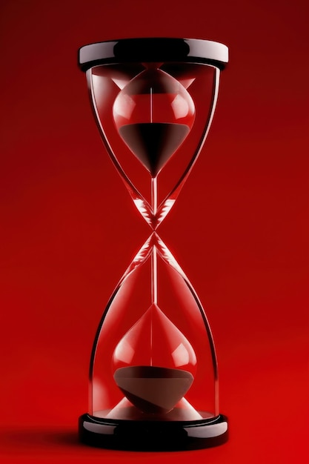
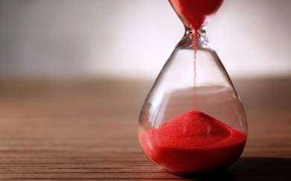
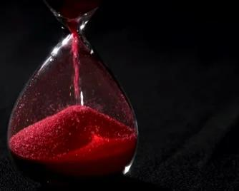
Time
Color Image 9 Concept: Image of an hour glass
*Close Up* Iso: 1600 Aperture: F5 Shutter Speed: 1/8 “My mind is set like a military clock. They had to elucidate; I couldn’t possible grasp the demand to undo everything I know. I was against time, engulfed in a relationship that infuriated me.
But it was time, to deconstruct and escape my imprisonment. Time is my friend. In due time, it will be my friend”

Slide 11
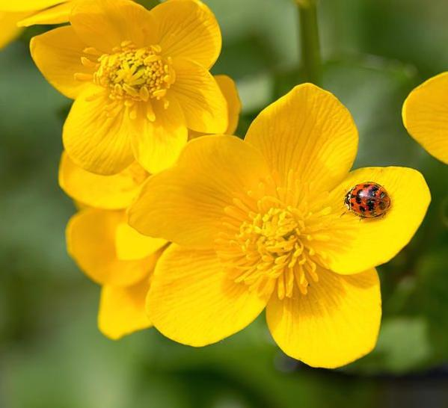
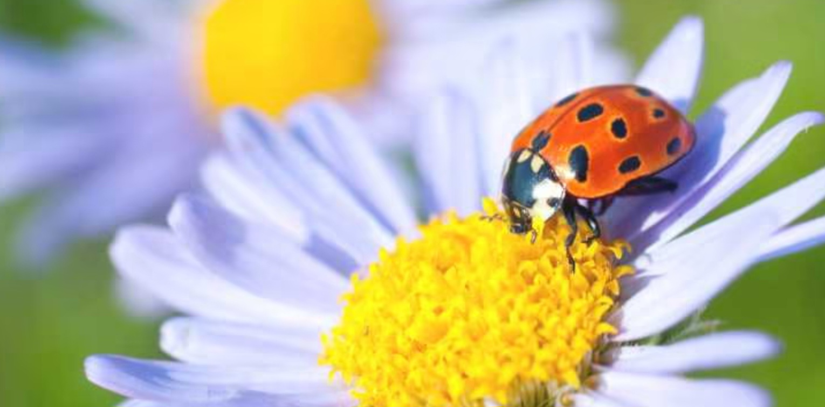
Clarity
Color Image 10 Concept: A ladybug resting on a leave through a magnifying glass.
*Medium Close Up* Iso: 200
Aperture: F5 Shutter Speed: 1/60
I noticed a different beauty, one where I recognized my face. All the mundane details were brought to my attention; there was an abundant amount of beauty, I was deeply appalled. I looked around; goodness me beauty was everywhere. I saw love, hope & my ears perked as I heard laughter nearby. I took a deep breath, filled my lungs with air and sighed deeply. The curtains have been lifted, I can see again.

Slide 12
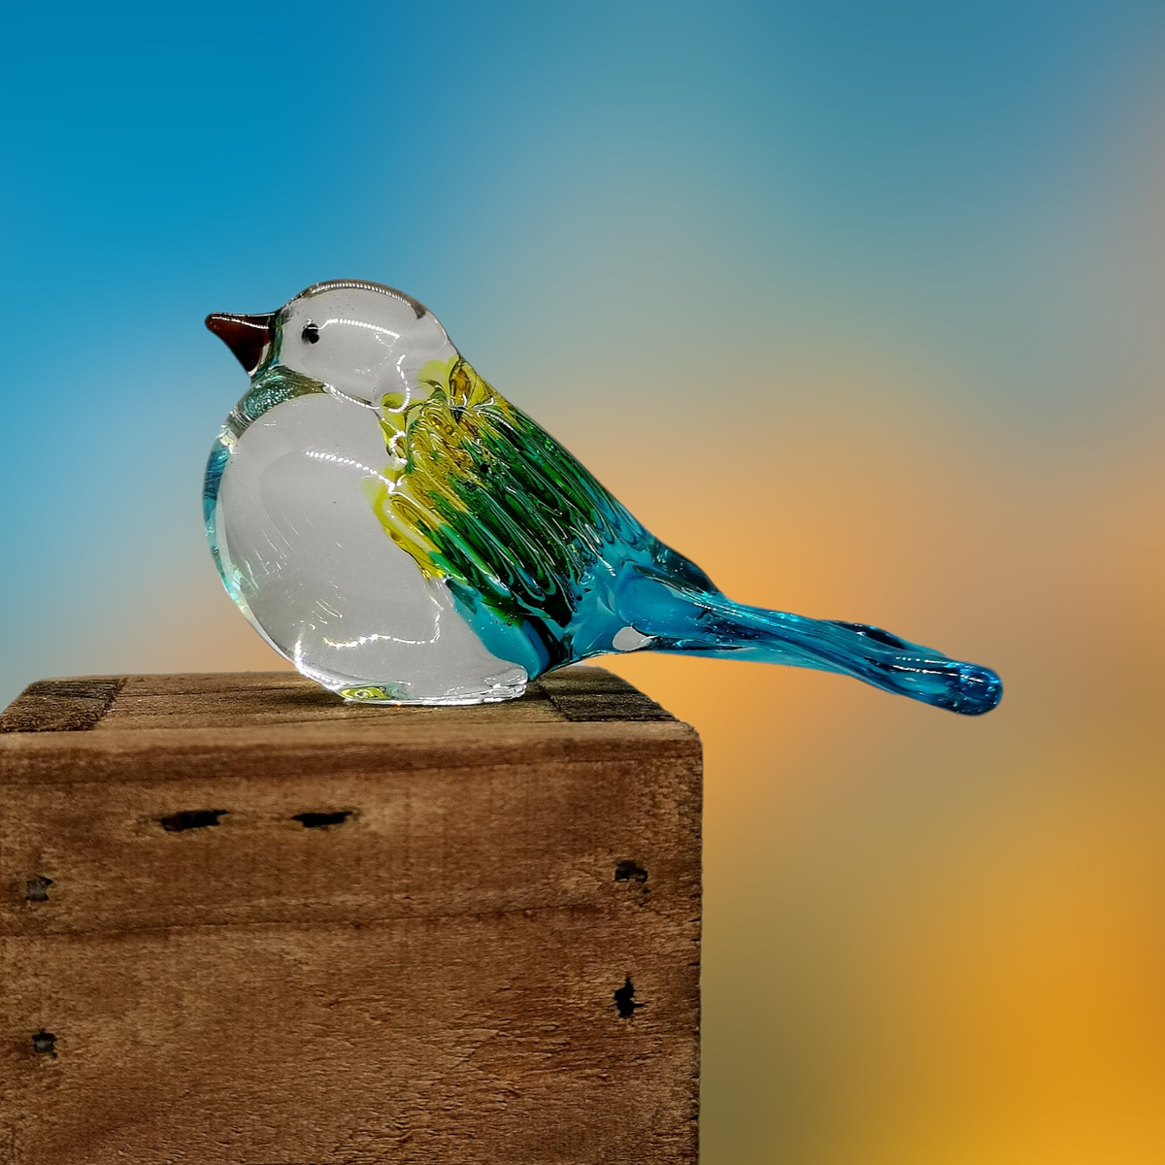
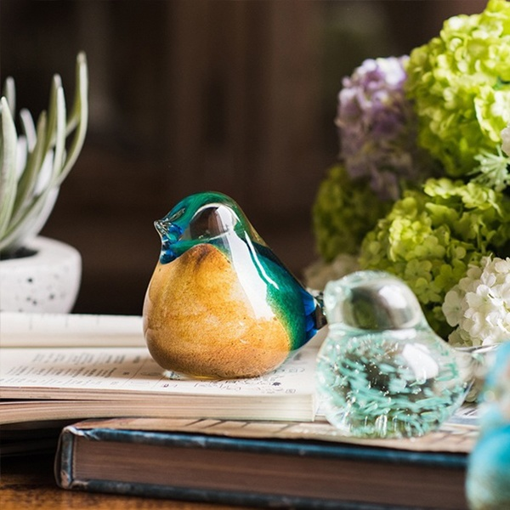
Mirror
Color Image 11 Concept: A glass bird
*Close up Wide* Iso: 100 Aperture: F4
Shutter Speed: 1/200
The reflection empowered me. I felt strength. Each cell of my body was in sync. My mind, heart & soul were together as one, working uniamously to not only survive but to live free. I morphed into an elevated woman, one determined to rise by any means necessary. The medal chains are dismantled. I’m ready to fly.

Slide 13
Joy
Co250or Image Concept 12: Hands forming a heart at the chest
*Medium Wide Shot*
Iso: 200
Aperture: F6
Shutter Speed: 1/125
“Grateful & thankful.
I have no words to express my gratitude.
I made it Mom.”

